Slide 1
View Controller Interaction

Slide 2
Controller – View -Connection
How do we get data from the Model to the View?
The Controller manages the view which is presented to the client.
The view can get the values from the session or request object.

Slide 3
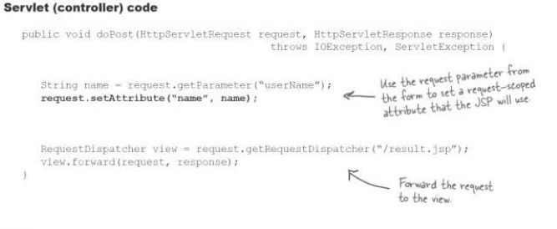
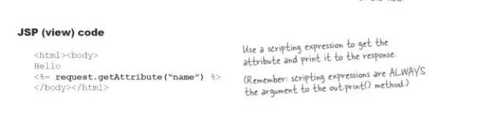
Controller Example

Slide 4
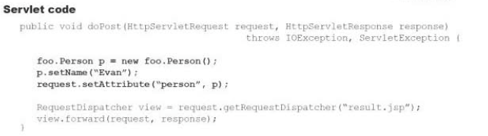
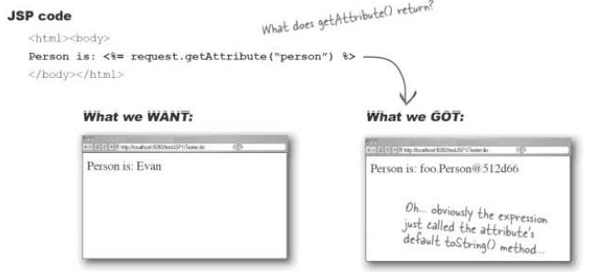
When an Attribute is an Object

Slide 5
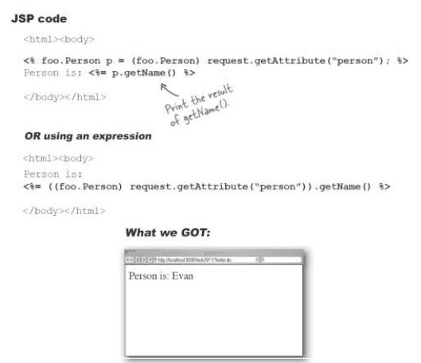
JSP to Access Objects

Slide 6
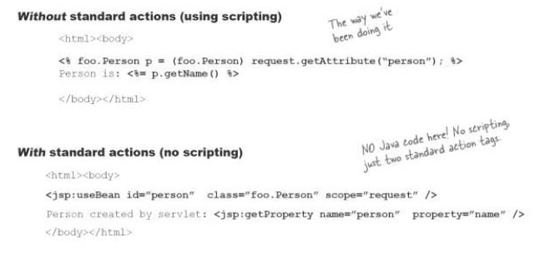
Standard Actions

Slide 7
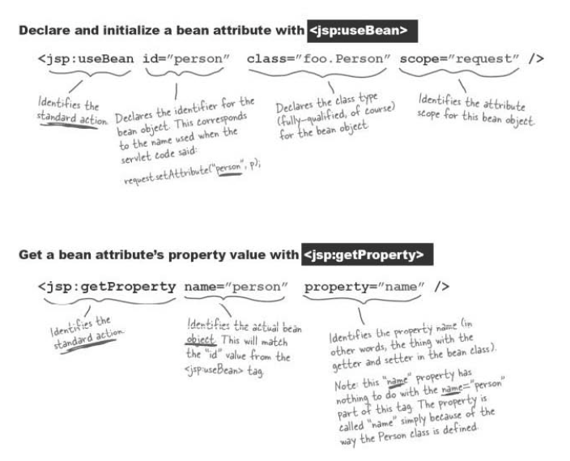
Anatomy of Standard Actions.

Slide 8
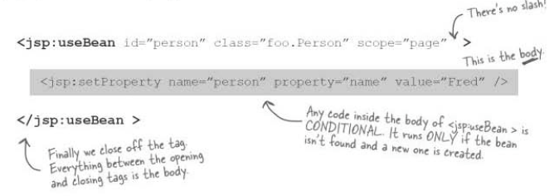
Setting a value using JSP Bean.

Slide 9
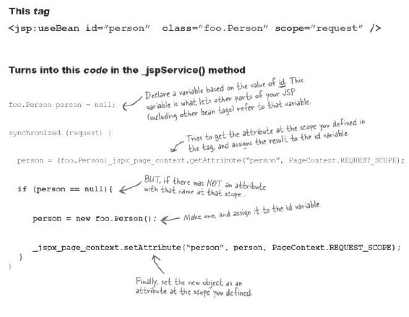

Slide 10
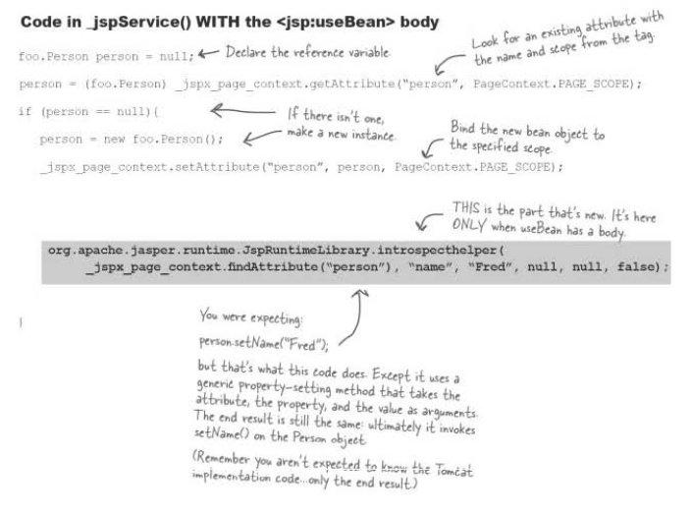
Servlet code

Slide 11
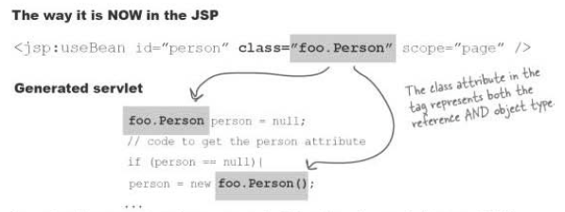
Polymorphic bean reference

Slide 12
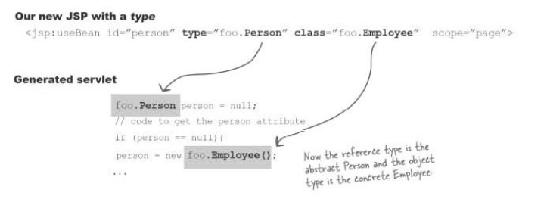
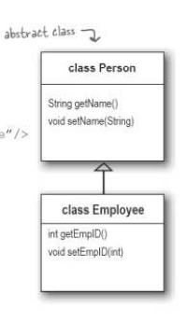

Slide 13
